Slide 1
Arithmetic Expression Language
Name : Daxesh Patel
Roll No: IT-130
Clg ID: 17ITUOD002
Guided by: Prof.Roshni Raval

Slide 2
Features of Language
The language provide calculation of simple arithmetic operations like addition , subtraction , multiplication , division and modulus.
It can evaluate any expression written between normal brackets.

Slide 3
LEX PART:
%{
#include<stdio.h>
#include "y.tab.h"
extern int yylval;
%}
%%
[0-9]+ {
yylval=atoi(yytext);
return NUMBER;
}
[\t] ;
[\n] return 0;
. return yytext[0];
%%
int yywrap()
{
return 1;
}

Slide 4
YACC PART:
%{
#include<stdio.h>
int flag=0;
%}
%token NUMBER
%left '+' '-‘ %left '*' '/' '%'
%left '(' ')'
%%
ArithmeticExpression: E{
printf("\nResult=%d\n",$$);
return 0;
};
E:E'+'E {$$=$1+$3;} $ is result, +is $2
|E'-'E {$$=$1-$3;}
|E'*'E {$$=$1*$3;}
|E'/'E {$$=$1/$3;}

Slide 5
|E'%'E {$$=$1%$3;}
|'('E')' {$$=$2;}
| NUMBER {$$=$1;} ;
%%
void main()
{
printf("\nEnter Any Arithmetic Expression which can have operations Addition, Subtraction, Multiplication, Divison, Modulus and Round brackets:\n");
yyparse();
if(flag==0)
printf("\nEntered arithmetic expression is Valid\n\n");
}
void yyerror()
{
printf("\nEntered arithmetic expression is Invalid\n\n");
flag=1;
}

Slide 6
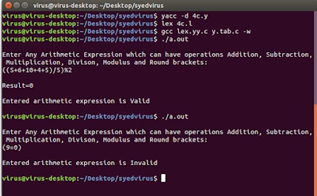
Output

